Slide 1
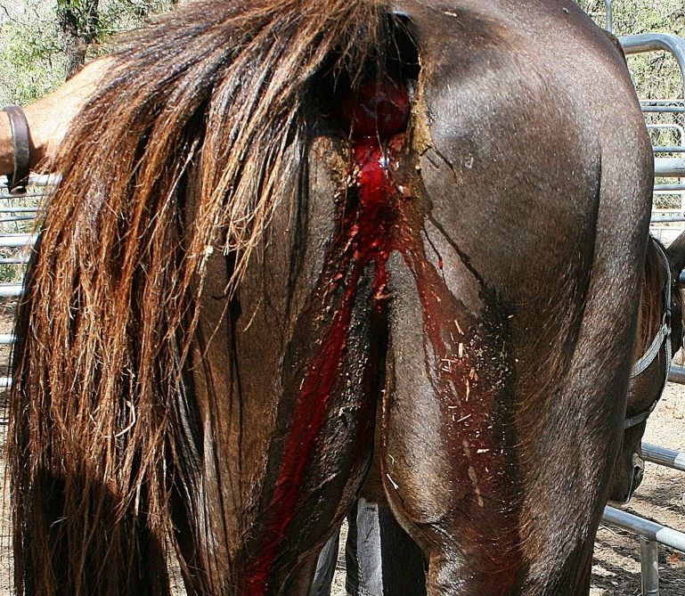
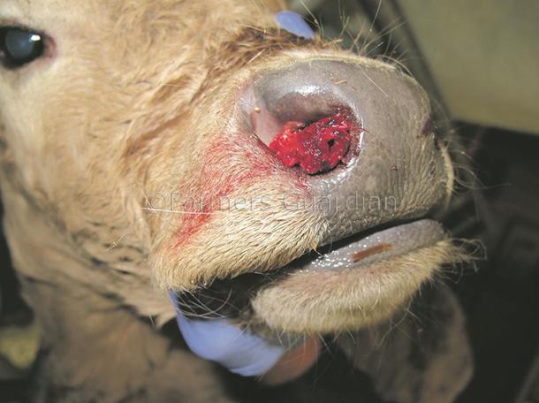
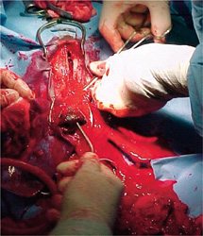
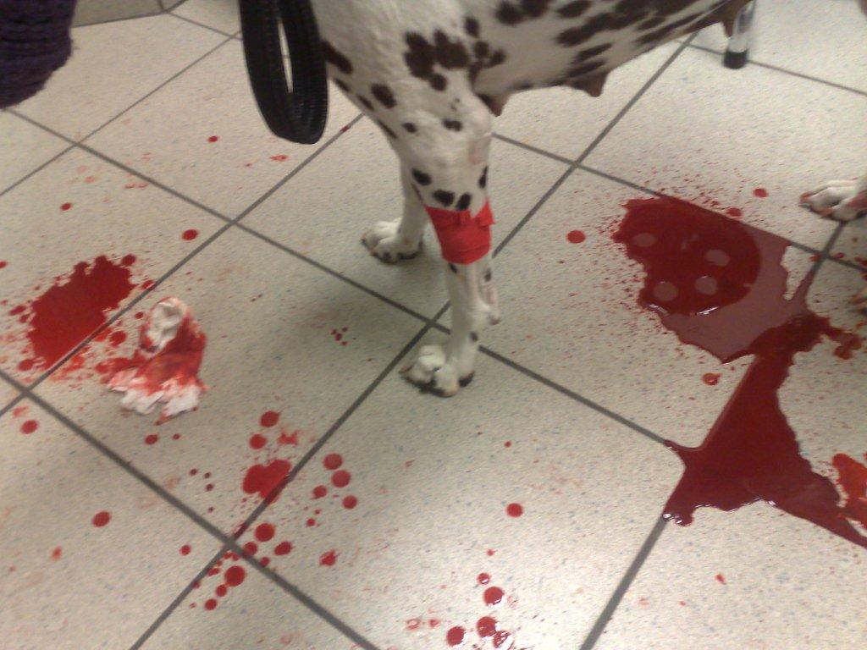
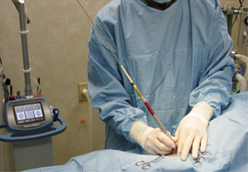
HEMORRHAGE AND HEMOSTASIS

Slide 2
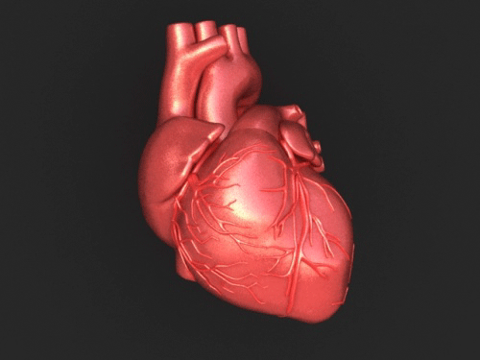
Classification
I-ACCORDING TO ORIGIN
1-Arterial Hemorrhage
1-Bright red in color
2-Occurs in jets
3-More profuse from the proximal end (heart side)

Slide 3
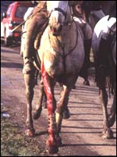
2-Venous Hemorrhage
1-It is dark red or blackish red in color
2-Flows in steady stream without pulsation
3-Appears from the distal end of the divided vessel

Slide 4
3-Capillary Hemorrhage
1-The blood color changes gradually from dark bluish color (venous blood) to bright reddish color (arterial blood)
2-Generalized oozing from the injured surface
3-The flow has short duration

Slide 5
II. ACCORDING TO LOCATION
1-External Hemorrhage
A-Epistaxis
B-Hemoptysis
C-Hematemesis
D-Hematuria
E-Melena

Slide 6
2-Internal Hemorrhage
A-Subcutaneous or tissue hemorrhage
i.Petechiae or petechial hemorrhage
ii.Ecchymosis
iii.Hematoma
B-Deep or Concealed Hemorrhage

Slide 7
III-ACCORDING TO TIME OF OCCURRENCE
1-Primary Hemorrhage
2-Intermediate or Reactionary Hemorrhage
3-Secondary hemorrhage

Slide 8
HEMOSTOSIS
Fibrinogen
Prothrombin
Ca++
Thrombin
thrombokinase or thromboplastin
Fibrine

Slide 9
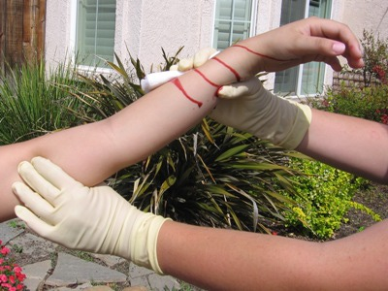
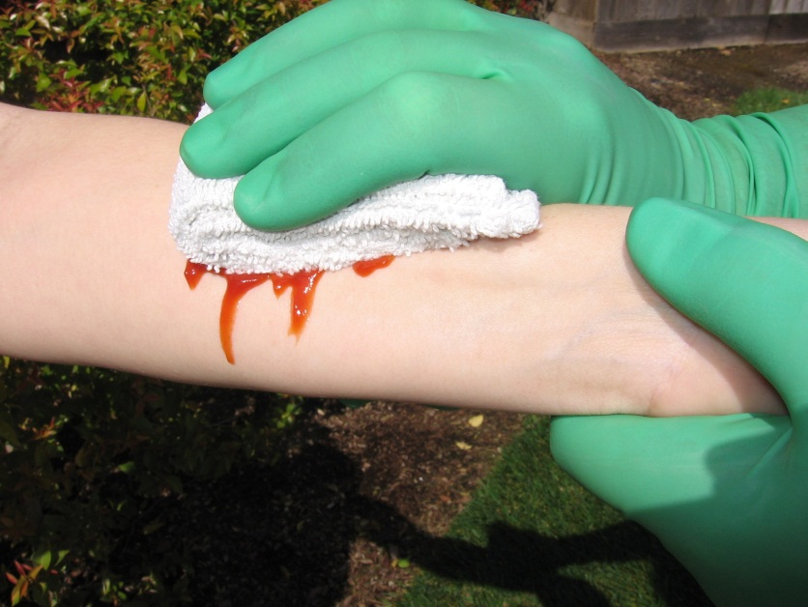
I-SPONTANEOUS or NATURAL HEMORRHAGE ARREST
II-TEMPORARY METHODS
1-Elevation of the bleeding part
2-Pressure bandage
3-Elastic ligature, tourniquet

Slide 10
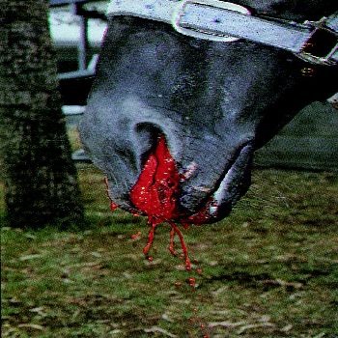
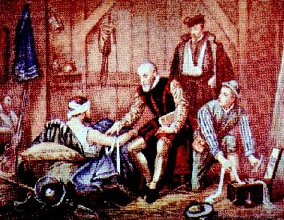
III-PERMANENT METHODS
1-Physical Methods
1-Application of cold water or ice
2-The use of hot red iron

Slide 11
2-Chemical Methods
A-Locally
1-Alum
3-Silver nitrate
2-Copper sulfate
4-Ferric per-chloride
B-Locally and Systemically
1-Gelatin
3-Coaguline
2-Adrenaline
4-Ergometrine
C-Systemically
1-Vit. C
3-Calcium salts
2-Vit. K

Slide 12
3-Mechanical Methods
1-Crushing
2-Torsion
3-Ligature
4-Mass ligature
5-Emasculator
6-Tamponade

Slide 13
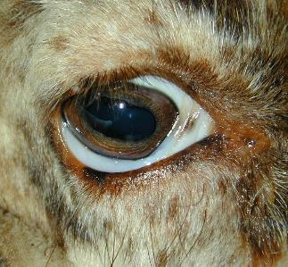
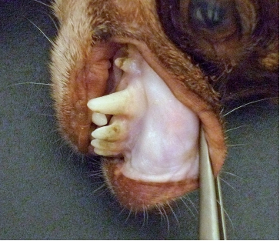
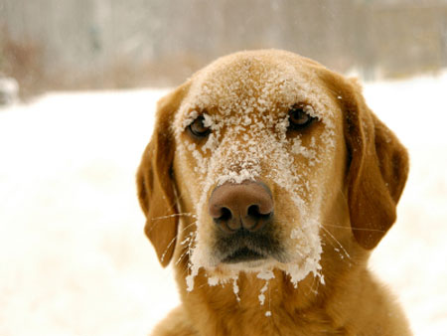
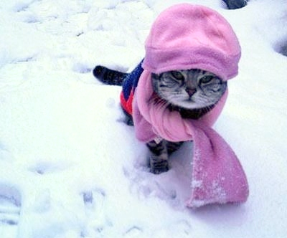
THREATENING HEMORRHAGE (FATAL HEMORRHAGE)
1-Pale mucous membranes
2-Hypothermia and coldness of ears, lips, tongue, and extremities

Slide 14
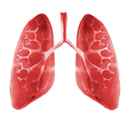
3-Fast weak heart beats (difficult to be palpated)
4-Shallow and rapid respiration
5-Sweating, exhaustion and muscles become relaxed with involuntary defection and urination

Slide 15
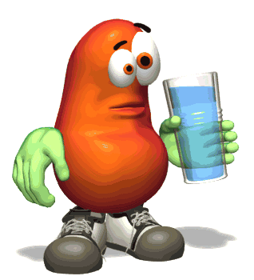
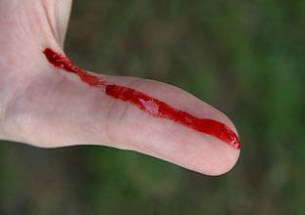
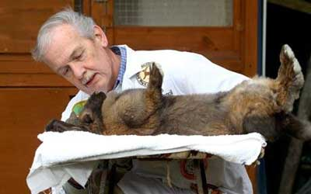
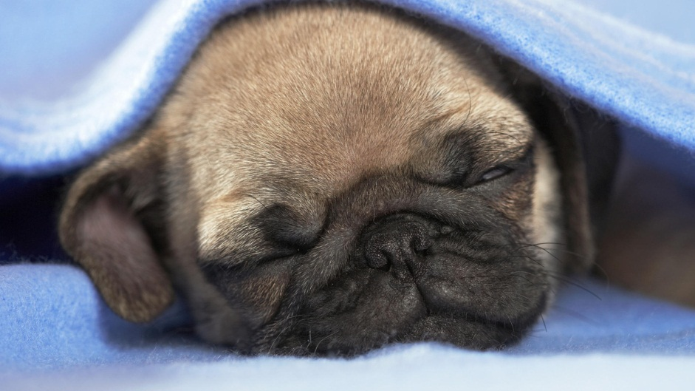
TREATMENT
1-Prevent water
2-Arrest hemorrhage
3-Heart tonics
5-Lowering of the head
4-Keep the animal warm
6-Fluid therapy and blood transfusion

Slide 16
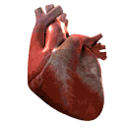
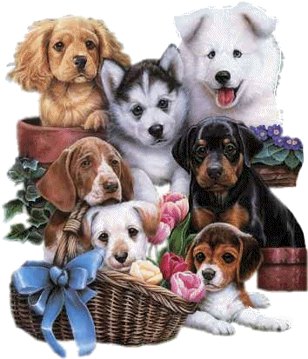
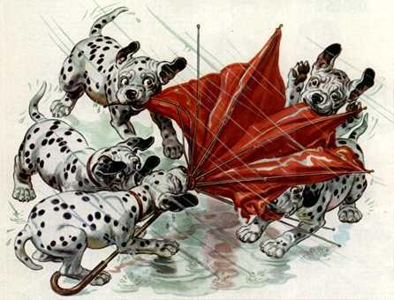
شكرا لحسن استماعكم

